Slide 1
Predicting daily Energy Consumption
Data science course final projecT – January 2021 – Rudy Malhi https://github.com/rudymalhi/data-science-course-final-project/blob/master/energy-consumption-v2.ipynb

Slide 2
The data
The main dataset contains ~60k records of the hourly energy consumption in the Chicago area (2004-2010)
Historical daily weather information for the area was obtained from the National Centers for Environmental Information (NCEI)

Slide 3
Preprocessing
The consumption data was grouped by date and merged with the daily weather data
Forward fill was used to fill in the days with missing temperature readings
While analyzing the data an outlier was found on the last day, probably caused by a partial reading, and was dropped
Using the holidays library a column was added to indicate a business day
A day of the week column was added

Slide 4
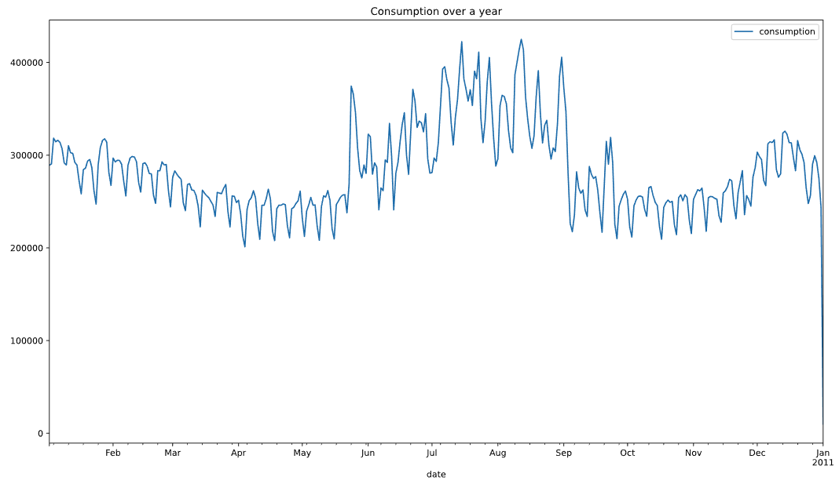
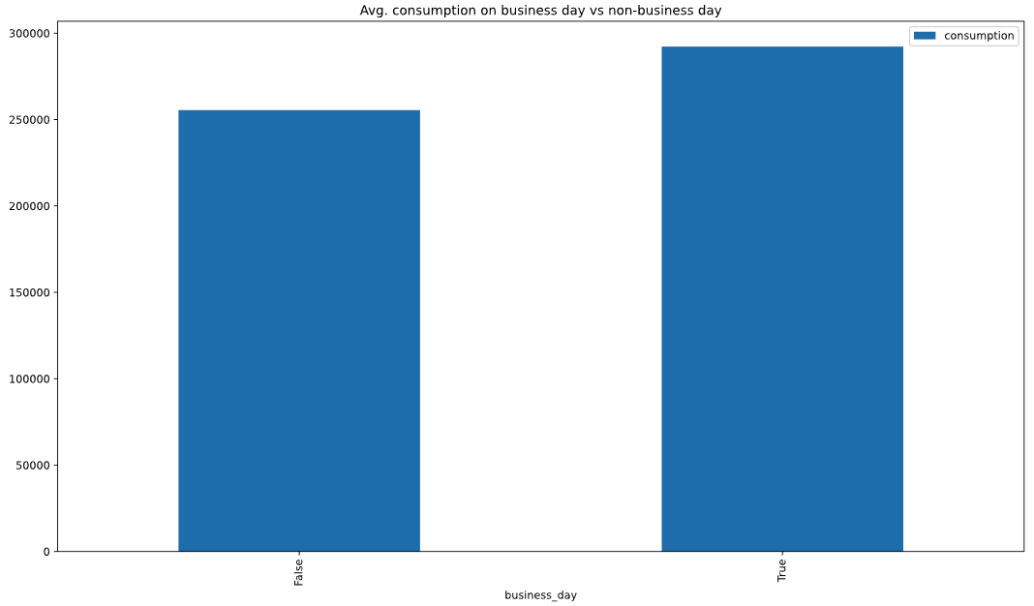
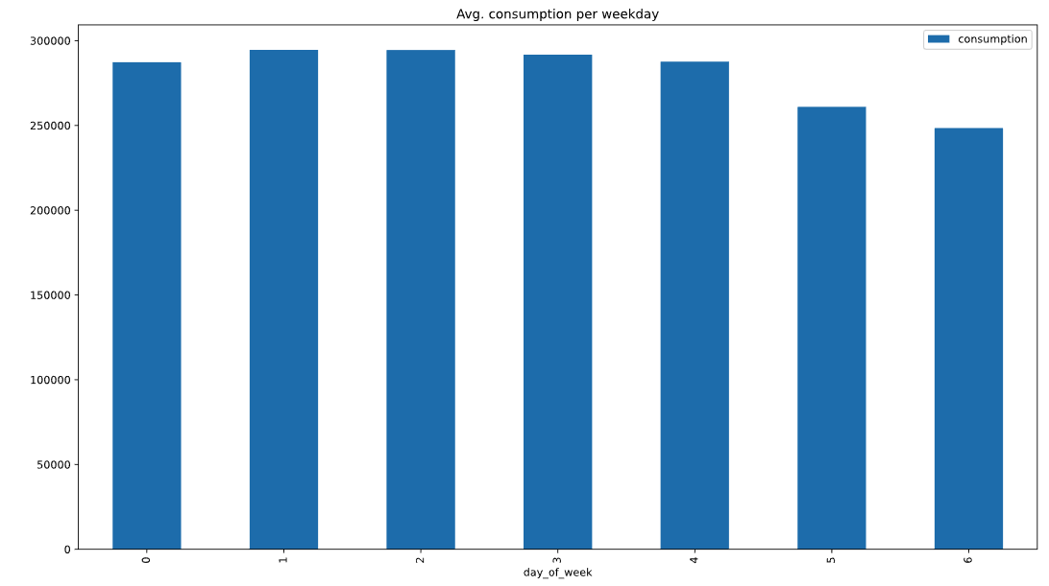
Visualizations
Outlier

Slide 5
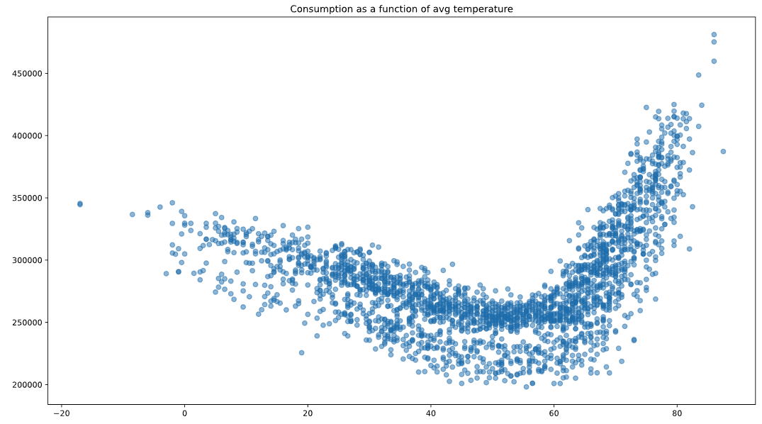
Visualizations (cont.)
We can see a curvilinear relationship between the temperature and the consumption. The consumption is a little higher when it's colder and much higher when it's warmer.

Slide 6
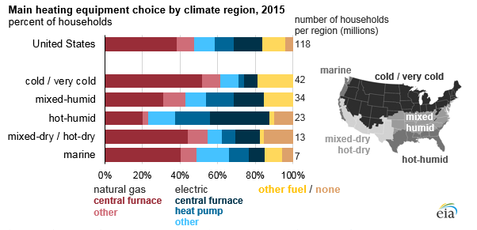
The Effect of cold temperatures on electric power consumption
Electric power is only used for heating in about 20% of households

Slide 7
Numeric Features
The numeric features are
Minimum daily temperature
Maximum daily temperature
Tansformations:
Polynomial transformation - there is clearly a curvilinear relationship between the temperature and the consumption
Standard scaler

Slide 8
categorical Features
The categorical features are
Business day
Day of the week
Tansformations:
One-hot encoding

Slide 9
Algorythm comparison
Linear Regression RMSE: 22,712
Ridge Regression RMSE: 16,218 Grid search used for tuning the alpha parameter and the polynomial degree Best parameters: alpha: 0.3981, degree: 9
Neural Network MLP Regressor RMSE: 15,015 Best parameters: activation='logistic’, alpha=0.1, hidden_layer_sizes=300
 | Consumption
Mean | 280,769
SD | 41,774
Min | 198,158
Max | 481,122

Slide 10
Improving the model
What if we added the temperatures of the prior day to the features?
RMSE: 16,202

Slide 11

Trying neural network
Neural Network MLP Regressor RMSE: 15,015
Best parameters: activation='logistic’, alpha=0.1, hidden_layer_sizes=300

Slide 12
Q&A

